Slide 2
Preparing for ALMA
http://science.nrao.edu/alma
National Radio Astronomy Observatory
North America ALMA Science Center
Charlottesville, Virginia U.S.

Slide 3

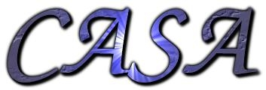
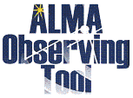

Preparing for ALMA: User Tools
Anthony J. Remijan
North America ALMA Science Center

Slide 4
Points to Take Home:
User tools include:
User Portal
ALMA Observing Tool
Project Tracker
Helpdesk
Common Astronomical Software Applications (CASA)
ALMA simulator
Splatalogue
The ARCs will provide full support for all user tools through an integrated helpdesk.

Slide 5
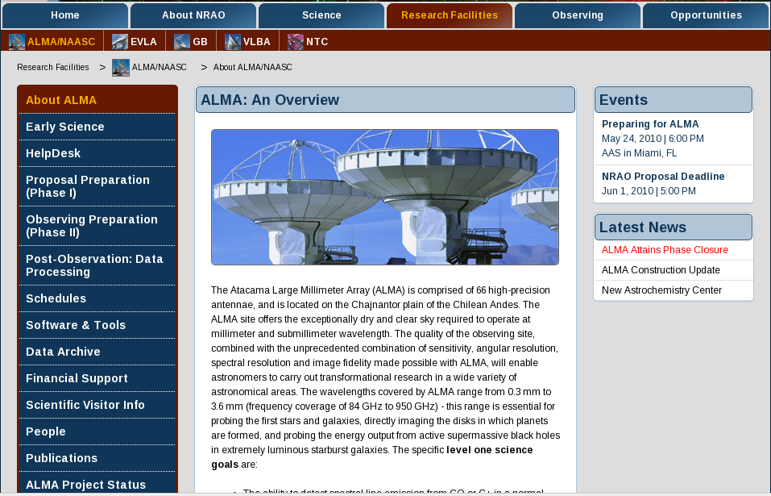
I’m already lost…where do I start??? Start with the User Portal:
Register with User Portal (single sign-on):
Helpdesk, Project Tracker, ALMA Science Archive
5
Notes:
5

Slide 6
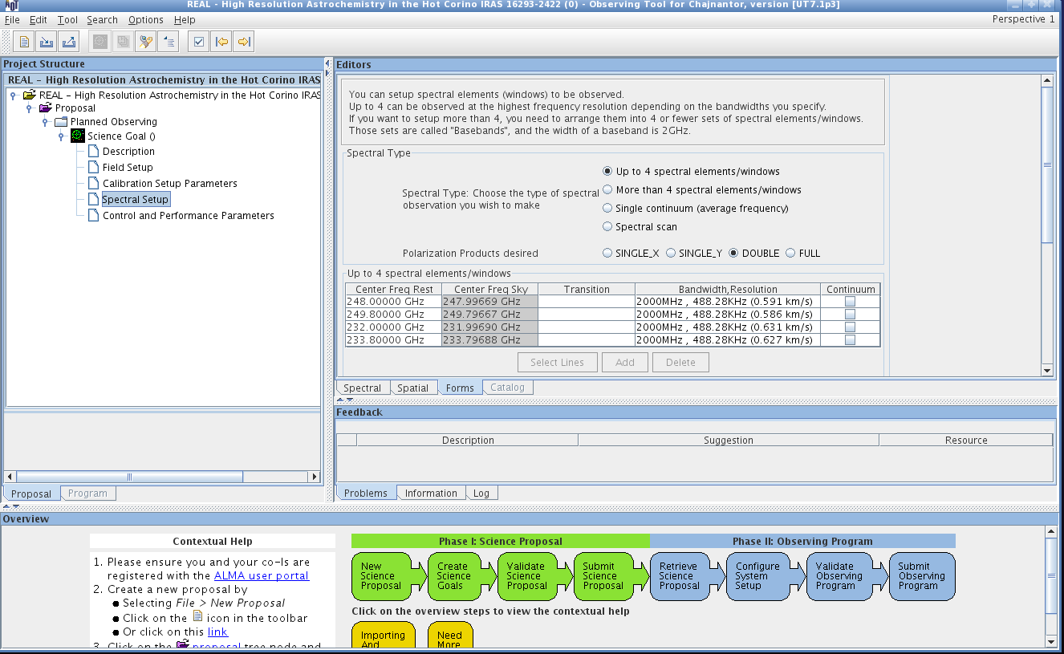
So far so good…now I want to write a proposal…? Download the ALMA Observing tool:
6
Notes:
6

Slide 7
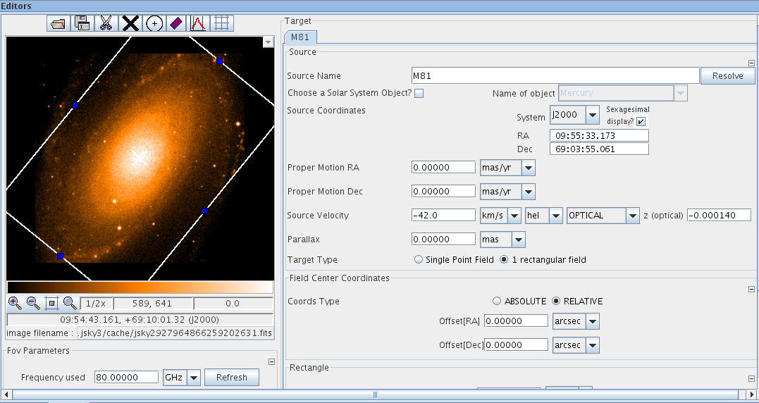
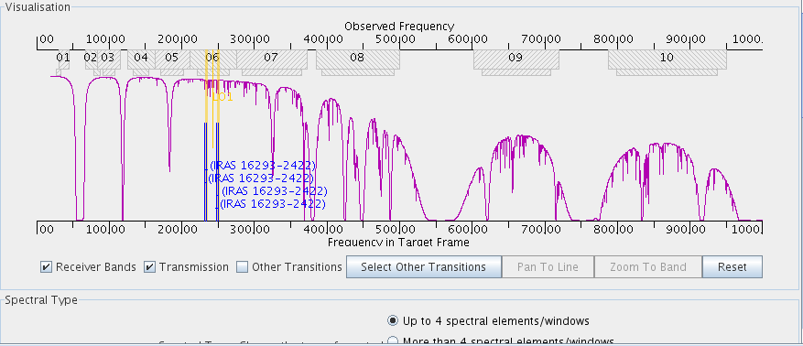
ALMA Observing Tool:
First “public preview” will be available July 20th
7
Notes:
7

Slide 8
What’s happening with my project?
The ALMA
Project Tracker:
8

Slide 9
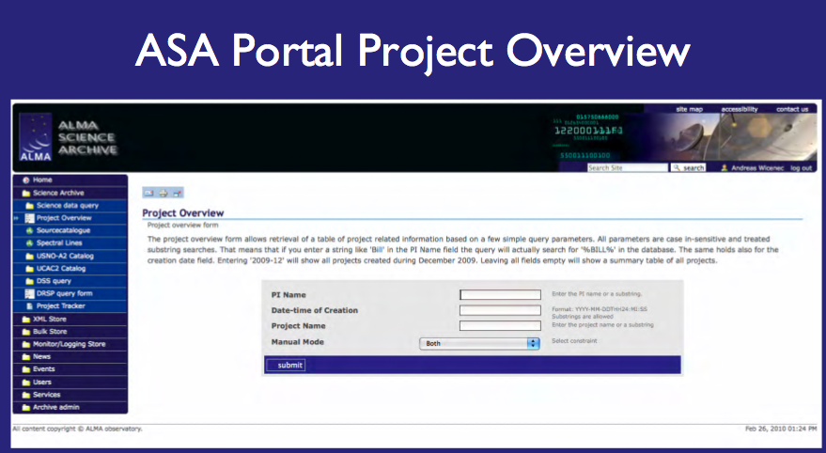
Great…where do I get the data?
9

Slide 10
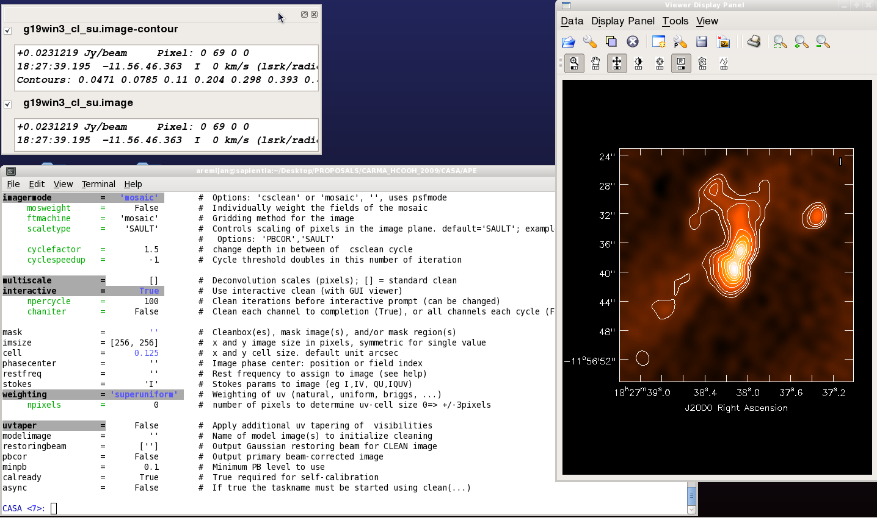
I got my data…now what?
What is CASA?
CASA is the post-processing package for ALMA and EVLA (interferometric and single dish)
Available at: casa.nrao.edu
10

Slide 11
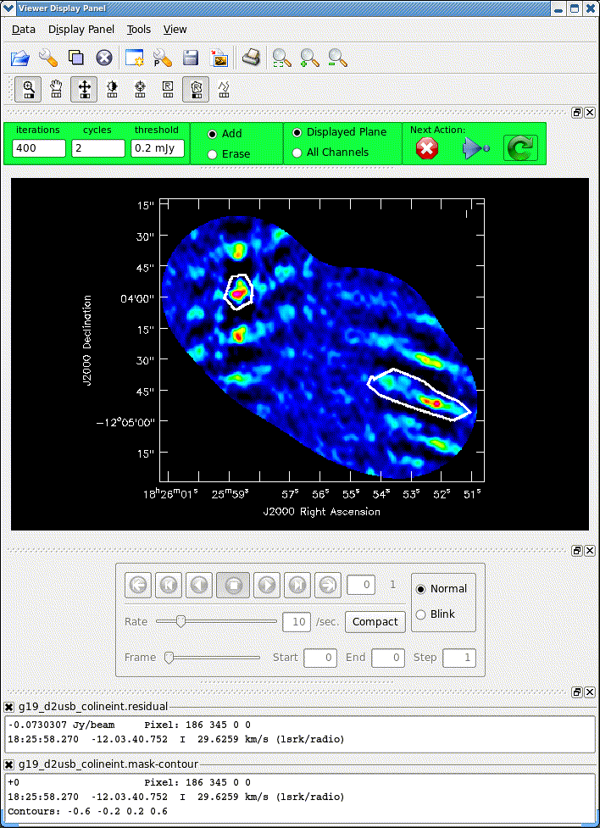
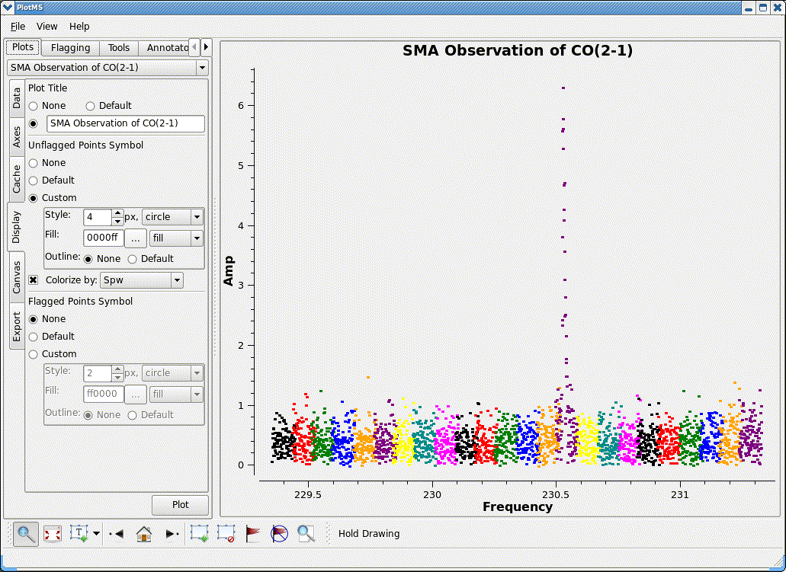
Interactive cleaning and flagging
UV-spectrum in plotms, colorized by spectral window
11

Slide 12
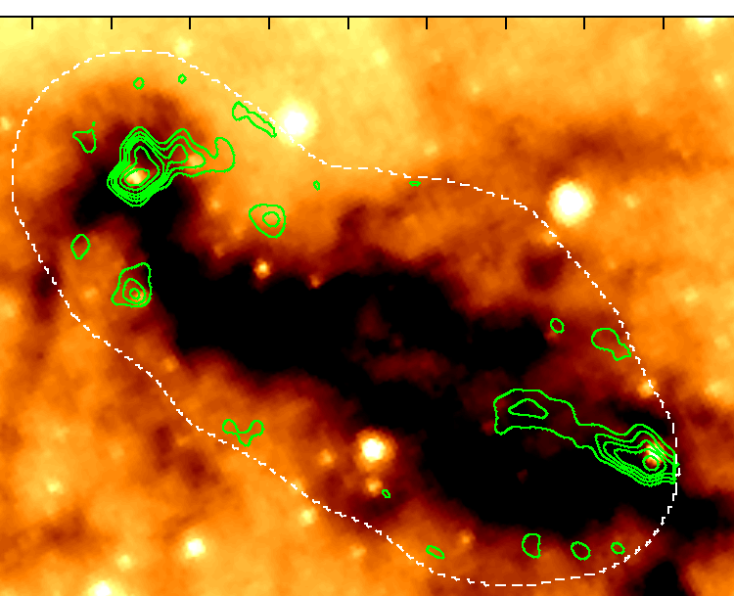
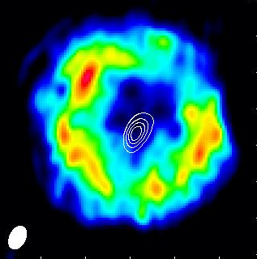
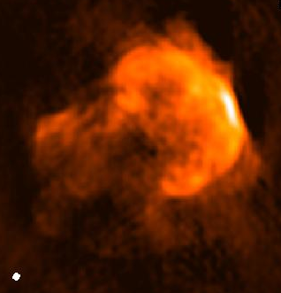
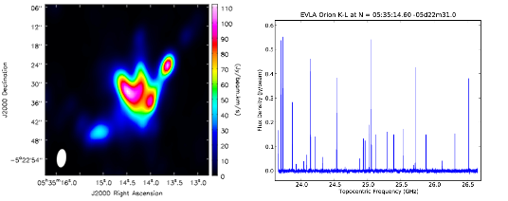
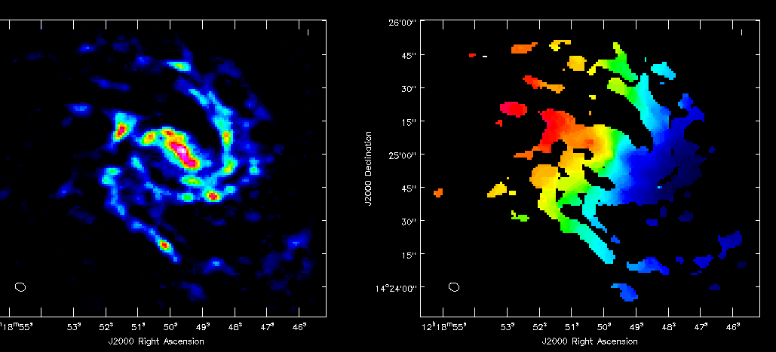
Diverse Data Reduced & Imaged in CASA…
SMA ¹²CO (2-1) mosaic toward IRDC G19.3+0.07
EVLA Ka-band of HC₃N in AGB star IRC+10216
EVLA 6cm mosaic of SNR: 3C391
EVLA demo science: Orion Hot Core this spectrum has 24k channels!
CARMA CO(1-0) mosaic of M99 (data courtesy STINGS team)
12

Slide 13
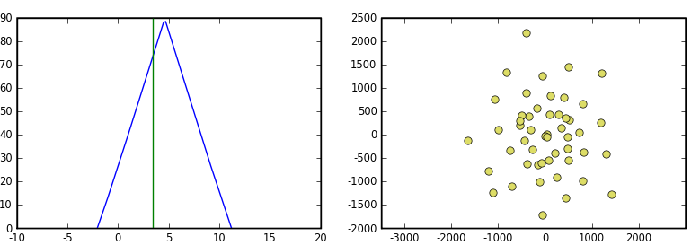
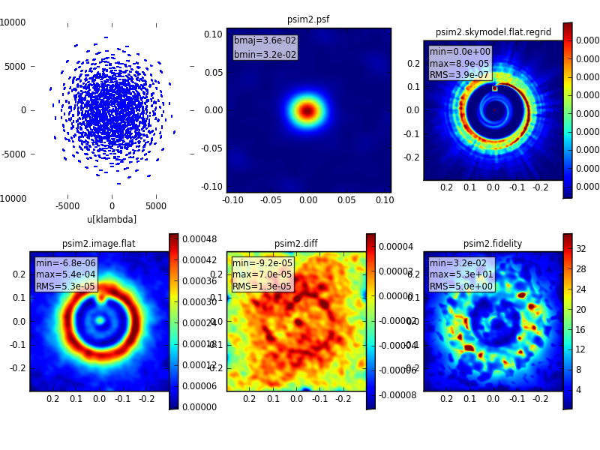
CASA Simulator: “simdata”
1-stop task to simulate ALMA, EVLA, SMA, CARMA, ATCA, SKA
Simulate continuum, simple cubes
Create coordinate system for model images
Automatically calculate mosaic pointings or manually
Optionally interleave a calibrator
Simulate total power observations
Add thermal noise and linear cross-polarization
Re-image the data, interferometric + total power
Analyze the difference in output and input images
13

Slide 14
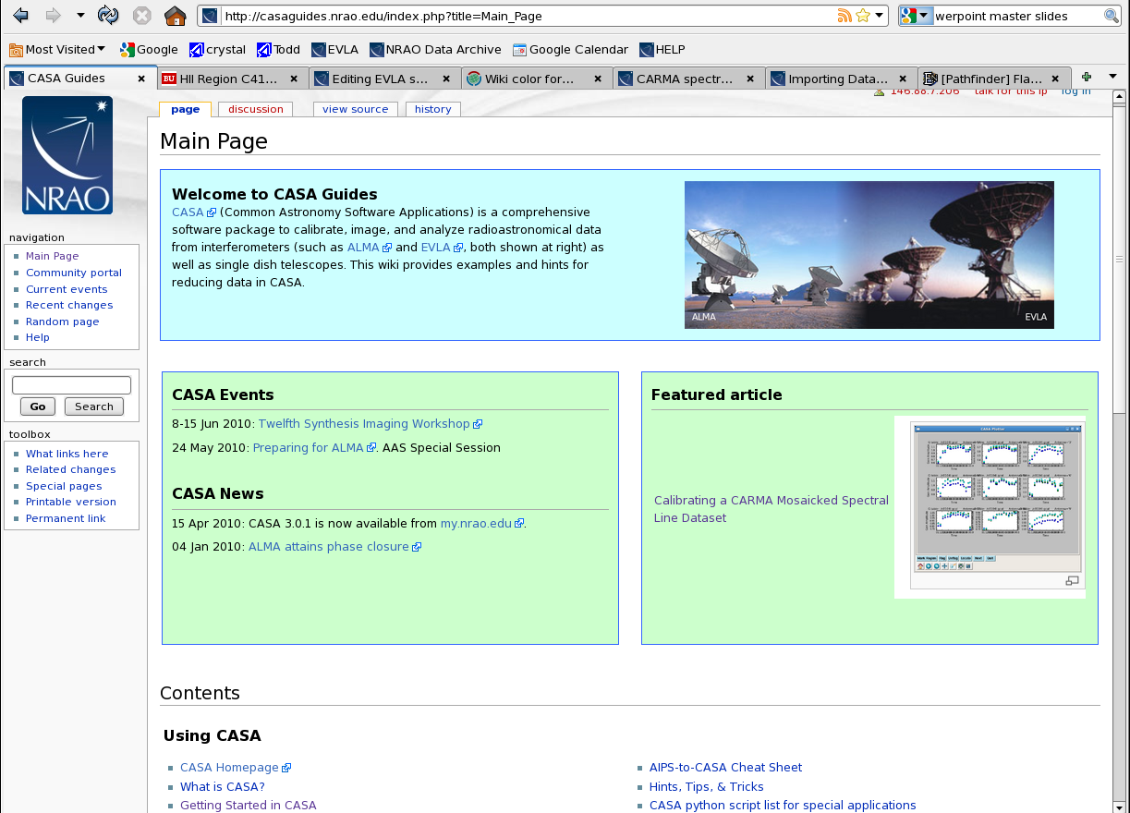
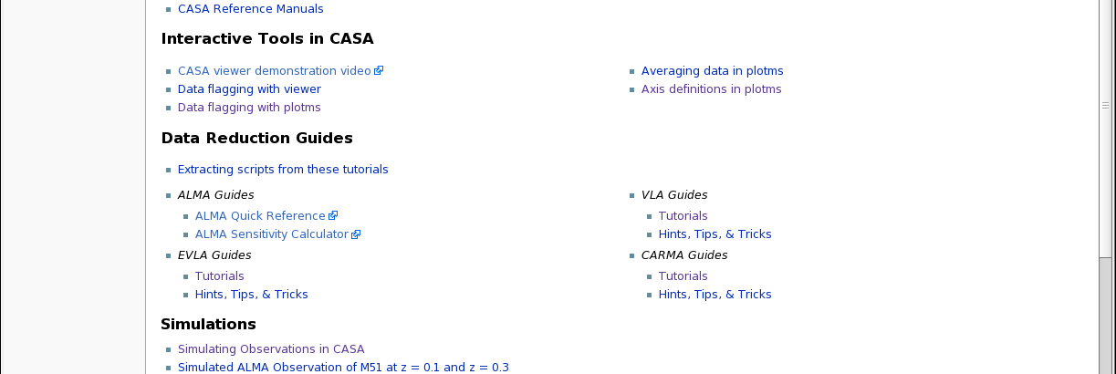
CASAguides
http://casaguides.nrao.edu
Uses mediawiki to enable fully annotated scripts
Additional “guides” continue to be added
NRAO Synthesis Imaging summer school tutorials will be delivered this way
14

Slide 15
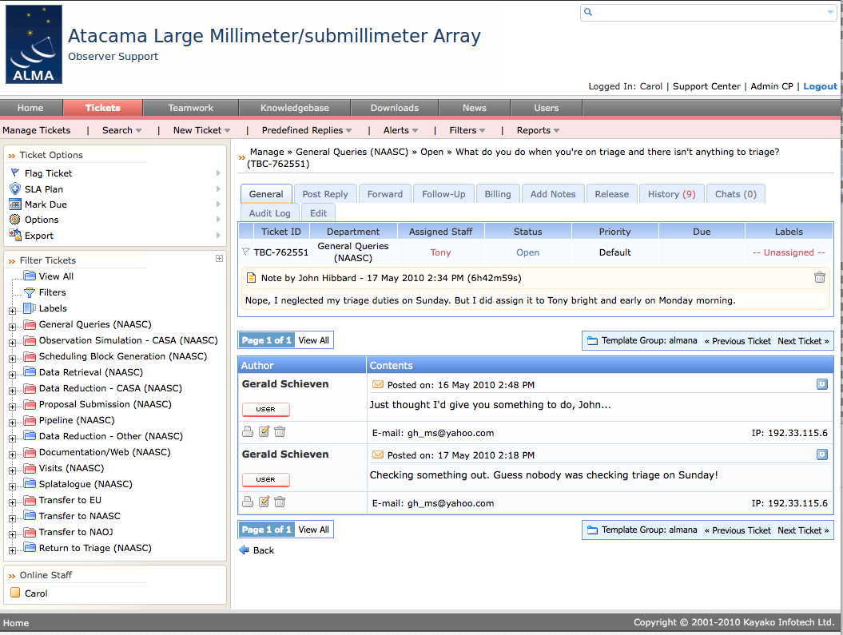
I really need help!
User's Committee Meeting, May 20, 21 2010
15

Slide 16
Splatalogue was created to satisfy ALMA’s need to have an up-to-date and complete spectral line database
Until now most observatory software included only a single catalog or ad hoc line list into their:
Observing tool
Proposal tool
Data reduction tool(s)
This is problematic because there are pros and cons associated with each individual list and moreover, these observatory line lists were almost never updated (e.g. BIMA) – a situation that ALMA cannot afford to follow
Our goal is to include all of the standard catalogs (i.e. JPL, CDMS) plus others from around the world (i.e. ToyaMA, SLAIM, OSU), and also recombination and atomic lines
16
Notes:
05/30/09
16

Slide 17
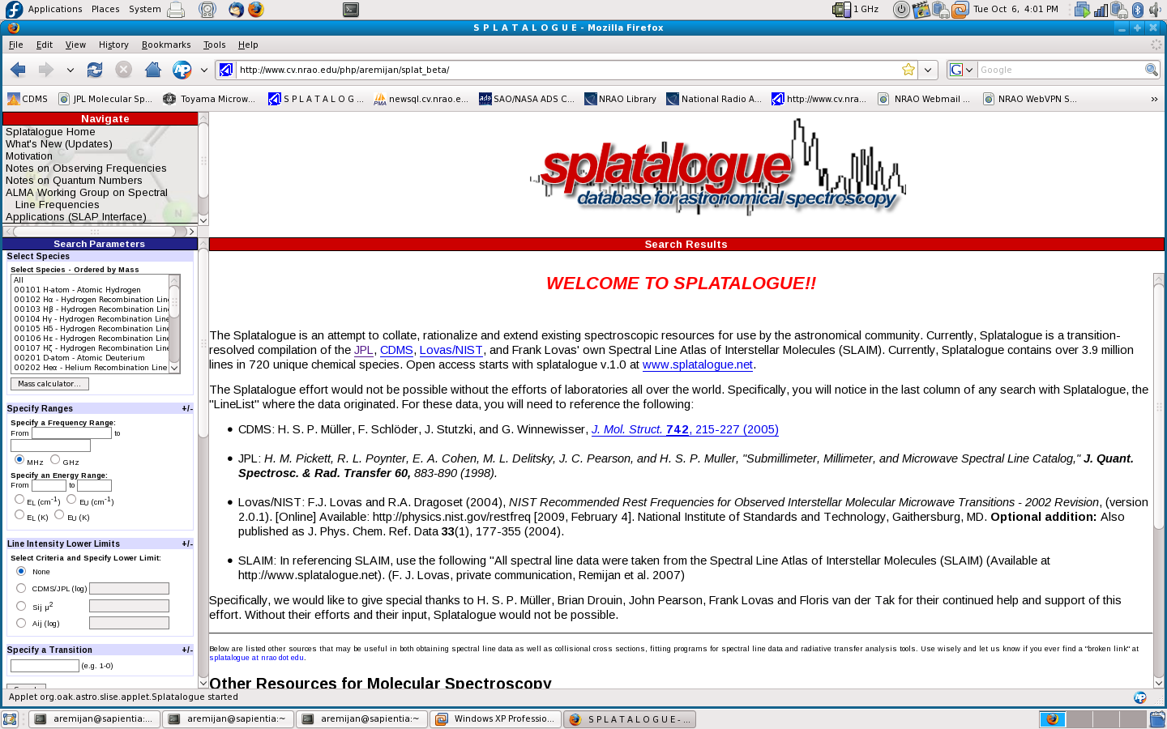
What else you got for us?
17
Notes:
05/30/09
17

Slide 18
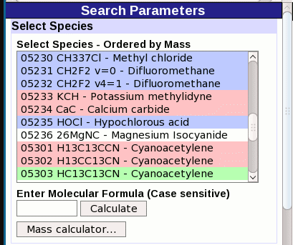
BLUE
(atmospheric)
RED
(possible)
WHITE
(known)
GREEN
(probable)
18
Notes:
05/30/09
18

Slide 19
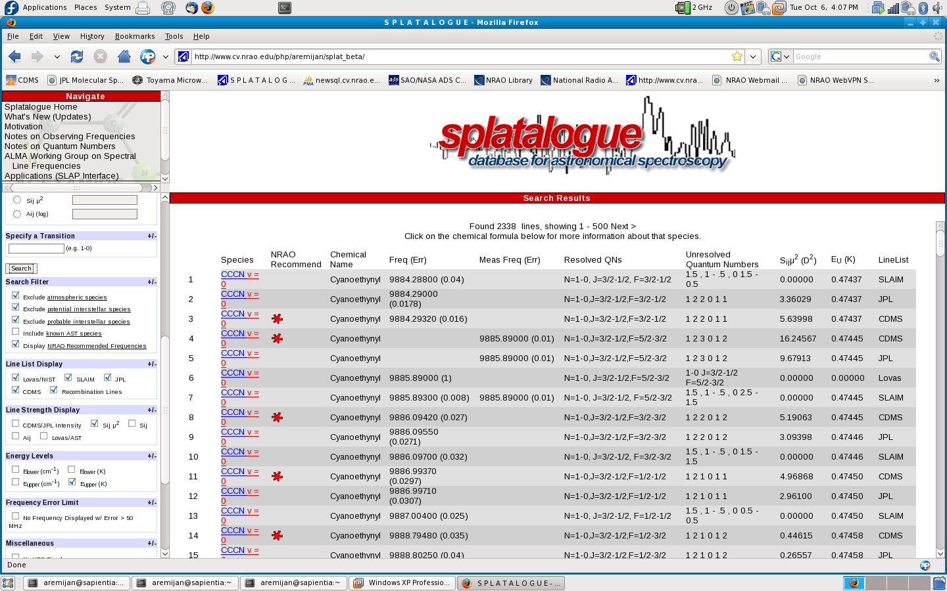
19
Notes:
05/30/09
19

Slide 20
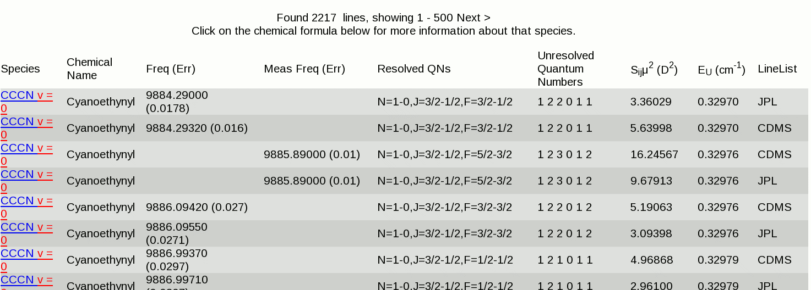
Note how Splatalogue reports the quantum numbers
“Click on” the chemical formula
20
Notes:
05/30/09
20

Slide 21
SLAP example with PHP
A Simple Line Access Protocol (SLAP) client written in PHP was created to test the new SLAP server at NCSA.
The class contains methods to query the SLAP service and return an XML file – readable by variety of VO programs and web services.
The class can be easily implemented in a web page or form.
It requires Chris Miller's IDL library, which is also included in the directory:
ftp://ftp.cv.nrao.edu/NRAO-staff/bkent/slap/idl/
Constructor (SLAPClient)
$slap = new SLAPClient ($slapurl);
Method (getRaw)
$xmlstr=$slap->getRaw ('queryData', $minwave, $maxwave);
Method (buildQuery)
$query = $this->buildQuery ($request, $wavelengthlower, $wavelengthupper, $verb, $keys);
XML
Slide provided by Brian Kent

Slide 22
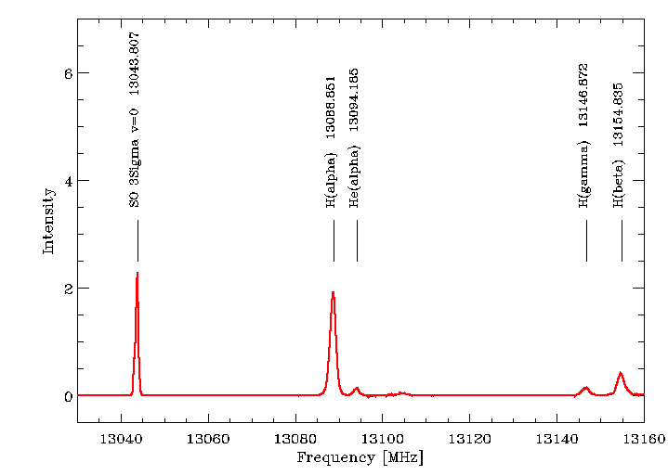
SLAP example with IDL
The SLAP service can be also used within a scripting or programmatic interface.
Using IDL:
GBT Ku-band spectrum
xrange=[13030.0,13160.0] ;MHz
minwave=c/(xrange[1]*1.0e6) ;meters
maxwave=c/(xrange[0]*1.0e6) ;meters
url='http://voera.ncsa.uiuc.edu:8080/ splat-slap/slap'
slapsearch, url, minwave, maxwave, slap
IDL> help, slap, /st
** Structure <a9c2054>, 9 tags, length=84, data length=84, refs=1:
CREATED STRING '2010-03-09'
TITLE STRING Array[1]
CATALOGNAME STRING Array[1]
WAVELENGTH DOUBLE 0.023060131
FREQUENCY DOUBLE 13000.466
MOLECULARFORMULA STRING Array[1]
MOLECULETYPE LONG 0 FREQUENCYRECOMMENDED LONG -999
QUANTUMNUMBERS STRING Array[1]
Slide provided by Brian Kent

Slide 23
A stable version of Splatalogue (v1.0)
http://www.splatalogue.net
And if you are not convinced yet…you may want to
Watch this
23
Notes:
05/30/09
23

Slide 24
Demos of Splatalogue, CASA and the OT will be available tomorrow from 2-4PM at the NRAO Booth
THANK YOU !!!
24
Notes:
05/30/09
24

Slide 25
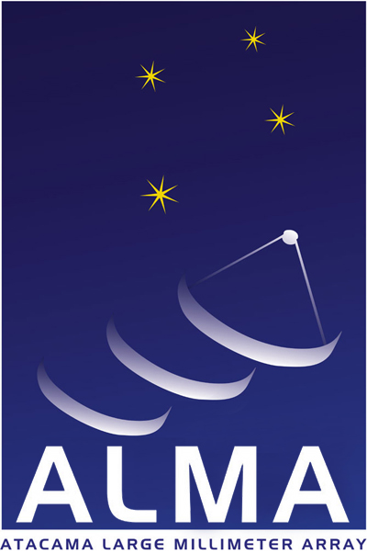
www.almaobservatory.org
The Atacama Large Millimeter/submillimeter Array (ALMA), an international astronomy facility, is a partnership among Europe, Japan and North America, in cooperation with the Republic of Chile. ALMA is funded in Europe by the European Organization for Astronomical Research in the Southern Hemisphere, in Japan by the National Institutes of Natural Sciences (NINS) in cooperation with the Academia Sinica in Taiwan and in North America by the U.S. National Science Foundation (NSF) in cooperation with the National Research Council of Canada (NRC). ALMA construction and operations are led on behalf of Europe by ESO, on behalf of Japan by the National Astronomical Observatory of Japan (NAOJ) and on behalf of North America by the National Radio Astronomy Observatory (NRAO), which is managed by Associated Universities, Inc. (AUI).

Slide 26
PREPARING FOR ALMA
http://science.nrao.edu/alma
National Radio Astronomy Observatory
North America ALMA Science Center
Charlottesville, Virginia U.S.

